Slide 1
Ericsson Internship Project Sprint 1 – Code Review
David Martin

Slide 2
Feedback from last review
Implement the remaining operations
Implement a simple way to extend the system
Focus on User Acceptance Tests
Clean Code

Slide 3
Extending the system
This was achieved by implementing the following Design Patterns :
Strategy Pattern (behavioural)
a pattern concerned changing algorithm implementations at runtime, without causing tight coupling.
Factory Pattern (creational)
In the Factory pattern, we create object without exposing the creation logic to the client and refer to newly created object using a common interface

Slide 4
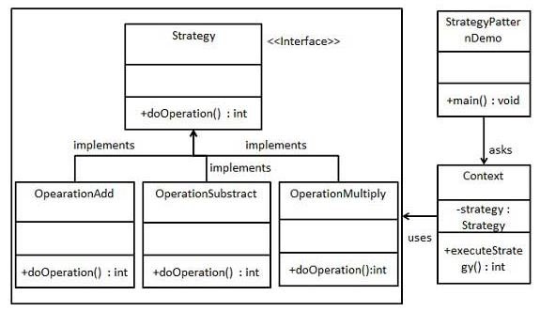
The Strategy Pattern
In Strategy pattern, we create objects which represent various strategies and a context object whose behaviour varies as per its strategy object.
The strategy object changes the executing algorithm of the context object.
Ref : https://www.tutorialspoint.com/design_pattern/strategy_pattern.htm

Slide 5
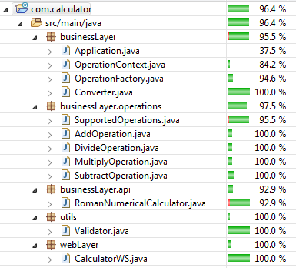
Test Strategy
Web Service:
Web Layer
Spock (Entrypoints)
Cucumber (UAT)
Business Layer
Spock (Mocking)
Domain Layer
Junit
Web Client
GUI – Selenium (Integration tests

Slide 6
